Slide 1
Pipelife Flush & Flow
In-wall flush toilet tank system

Slide 2
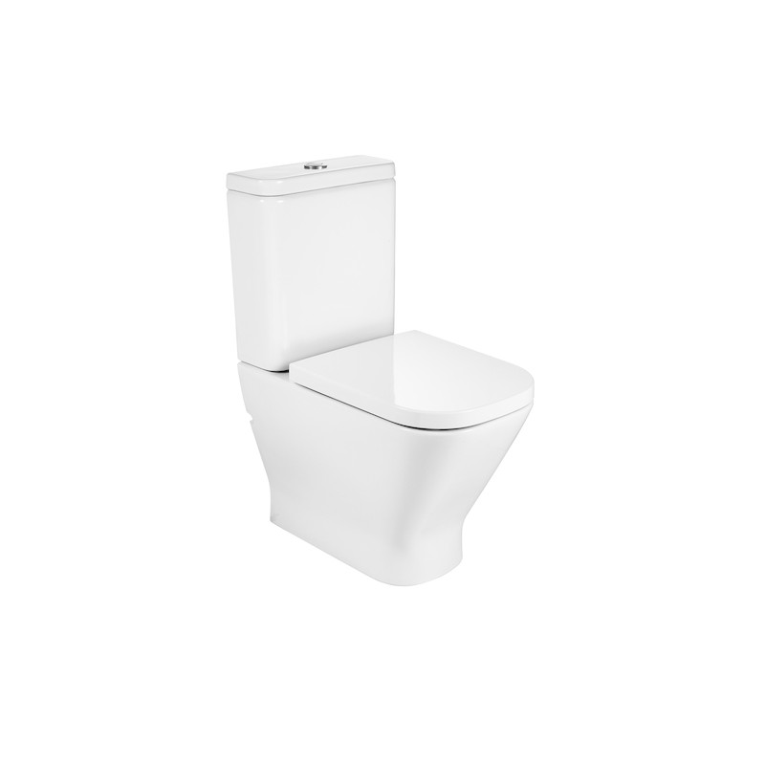
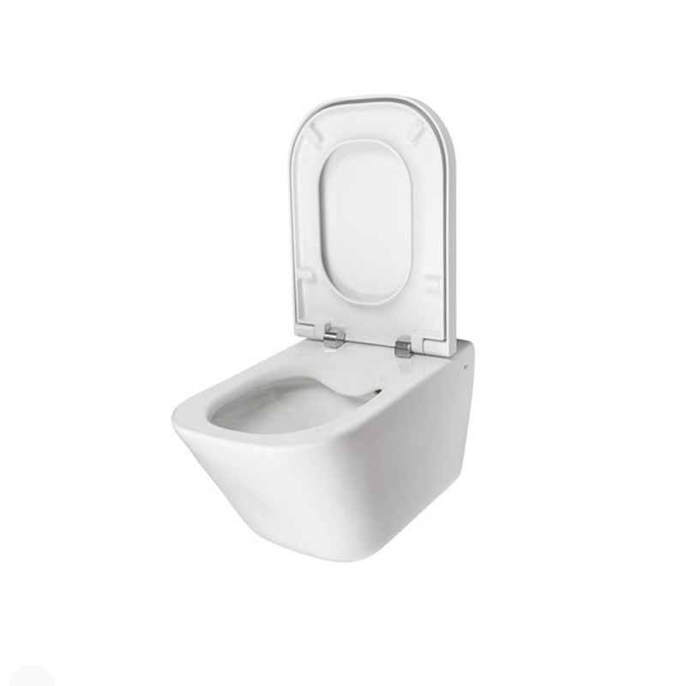
Why prefer the in-wall flush toilet tank
v/s

Slide 3
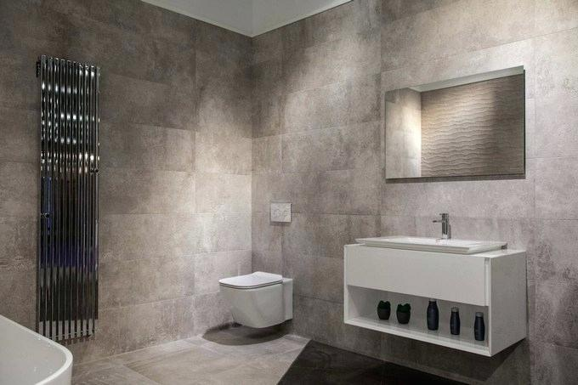
Pipelife Flush & Flow
The desired transformation of your bathroom
  Modern and attractive
  Functional
Use of the interior
  Better utilization of the interior even in small bathrooms
  Minimalism is now very popular

Slide 4
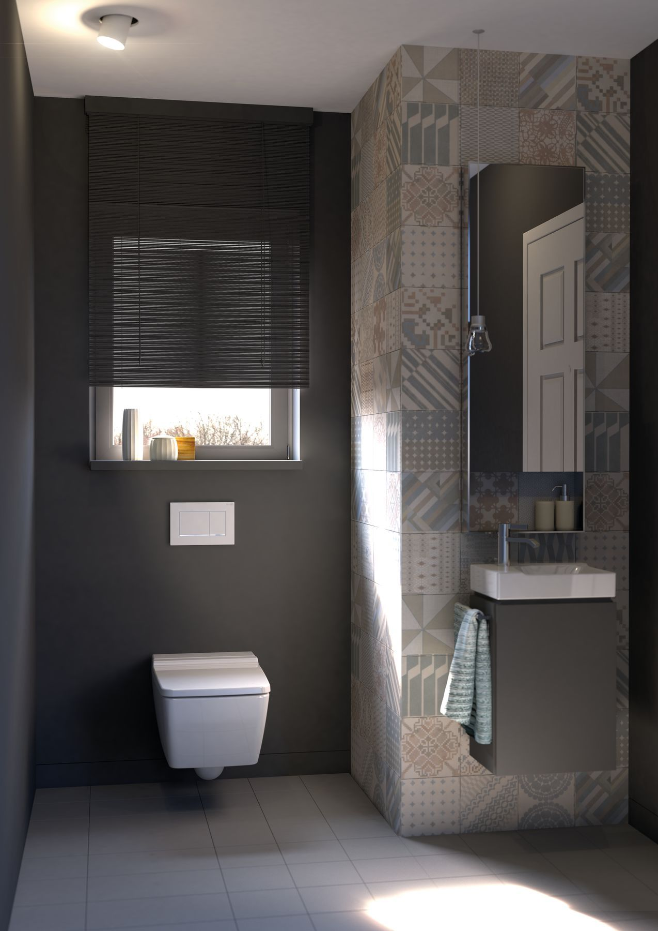
Pipelife Flush & Flow
Modern design every time
  Mounted in the wall instead of on the floor
  Providing new opportunities for design solutions for adding shelves, etc.
  The toilet bowl can be replaced individually without replacing the tank
  Easy to clean
  Vandal-proof

Slide 5
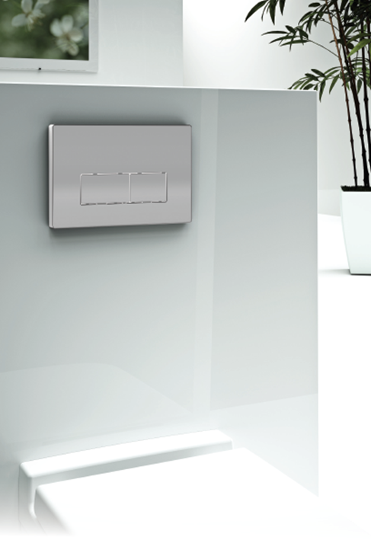
Buttons beauty and individuality

Slide 6
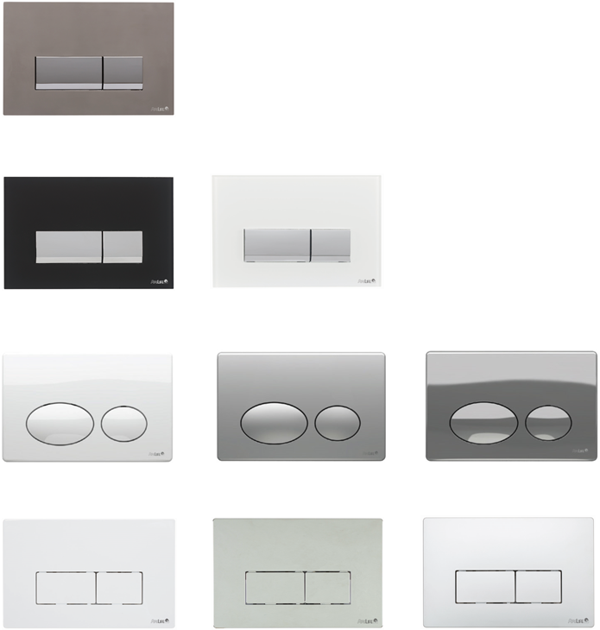
Pipelife Flush & Flow
ANGULATUS PREMIUM
  gloss chrome-plated steel
ANGULATUS PREMIUM
  black-and-white glass
OVATUS
  white, matt or glass chrome
ANGULATUS
  white, matt or glass chrome

Slide 7
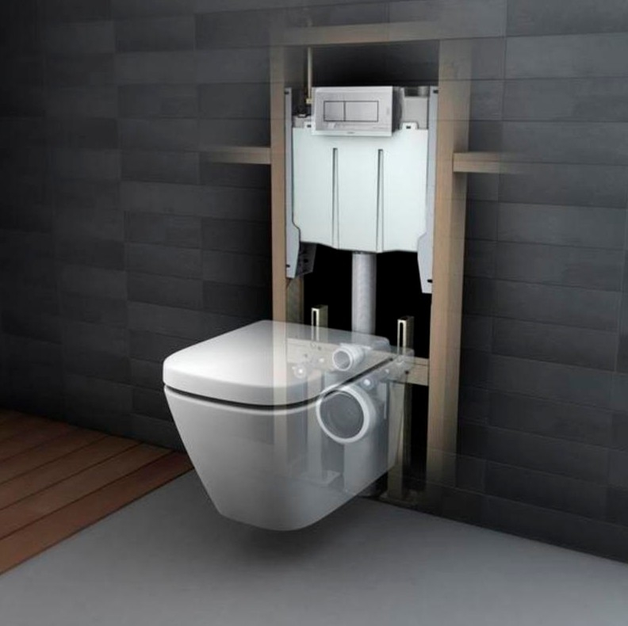
System review

Slide 8
Pipelife Flush & Flow
Here is what we guarantee

Slide 9
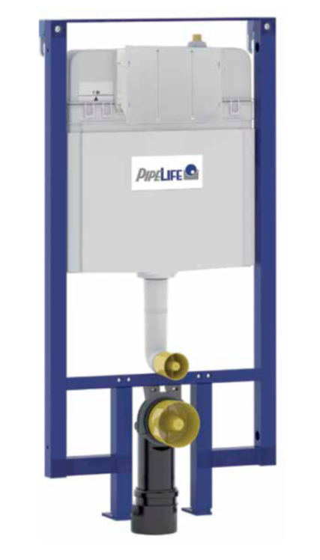
Pipelife Flush & Flow
Basic features
  Blue powder-coated steel structure
  Square profile 40x40 mm holding the pre-assembled flush tank
  Dual flush button (3/6 L)
  Options for adjusting the amount of water to be used (from 4-7L to 2-3L)
  Pre-mounted wall brackets and adjustable legs (0-200 mm)
  Upper connection to the water supply system
  Thorough insulation against condensation

Slide 10

Pipelife Flush & Flow
Special improvements
  Patented silent fill valve (Noise class 1 according to EN ISO 3822)
  Click locking system for secure installation
  The most thinnest tank of its class
  Possibility for corner wall installation
  Possibility for easy removal of all flush tank parts
  Possibility for height adjustment
  Possibility for mounting different types of toilet bowls
  Possibility for entirely in-wall installation

Slide 11

Pipelife Flush & Flow
The box includes:
  Flush tank equipped with pre-assembled shut-off valve and insulation
  Fitting 1/2” for connection to the water piping system
  PE elbow for connection to the sewer Ø 90 mm with sealing
  PE adapter Ø 90 / 110 mm with rubber sealing
  Assembly fastening kit
  Powder-coated steel structure
  Instructions for installation
  End caps for the outlets
  Optional kits for corner wall installation
  Optional kit including a hose for connection to the sewer

Slide 12

Innovative details

Slide 13
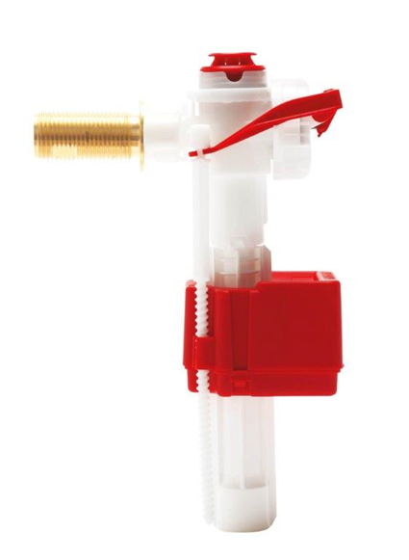
Pipelife Flush & Flow
Patented fill valve Pipelife Fluidmaster hydraulic servo valve 747
Efficient performance under both high and low water pressure: 0.2 - 16 bar
Ultra silent
Unmatched easy access and maintenance of the module
Self-cleaning membrane

Slide 14
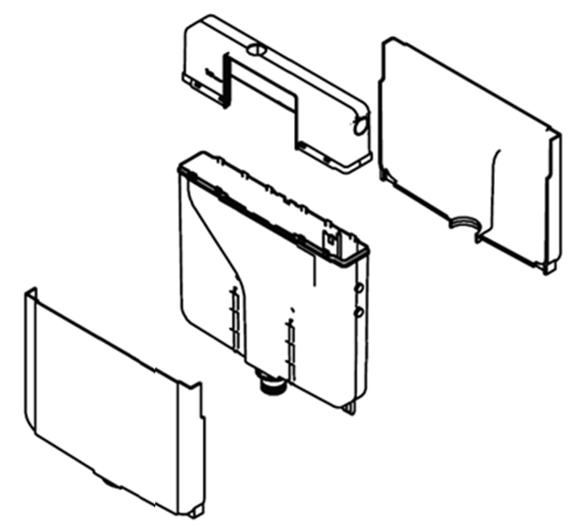
Pipelife Flush & Flow
Flush toilet tank
PP material
Volume 9 l
EPS (molded Styrofoam) heat insulation

Slide 15
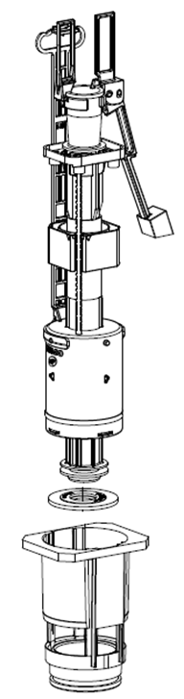
Pipelife Flush & Flow
Flushing mechanism
Factory default settings for:
  large flush 6L
  small flush 3L
Rubber joint allowing bending in case of deinstallation
Replaceable flushing mechanism

Slide 16
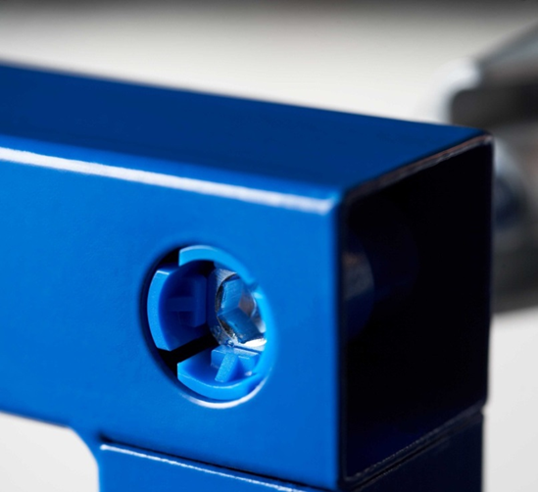
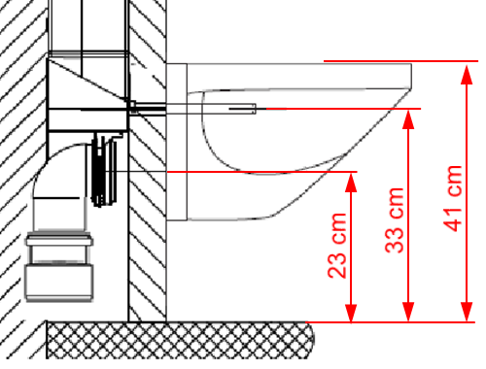
Pipelife Flush & Flow
Steel structure
4x4 cm square profile
Powder-coated for maximum protection against corrosion
Possible distances from the toilet bowl

Slide 17
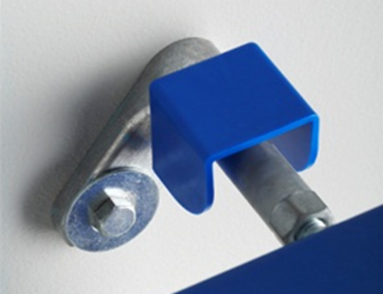
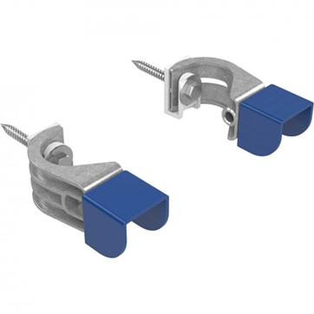
Pipelife Flush & Flow
Fasteners for in-wall installation
Flexible wall fittings and fasteners ensuring easy access for direct drilling and fastening
Corner wall installation kit – available as an accessory
Notes:
Wall fixation
Flexible wall brackets
Corner wall connection set – available as accessory

Slide 18
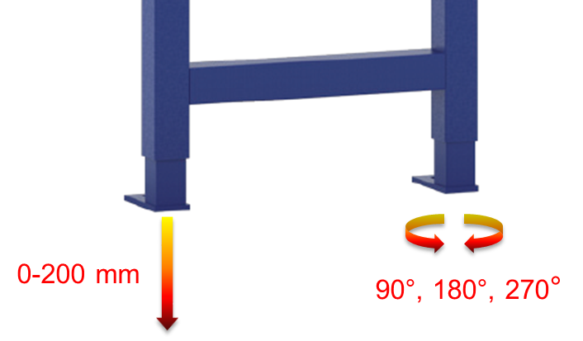
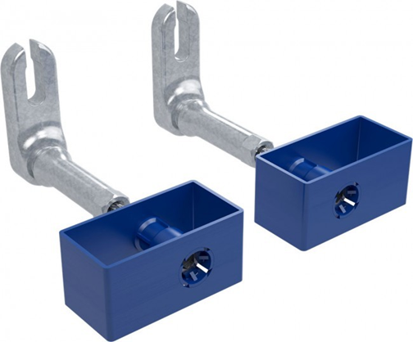
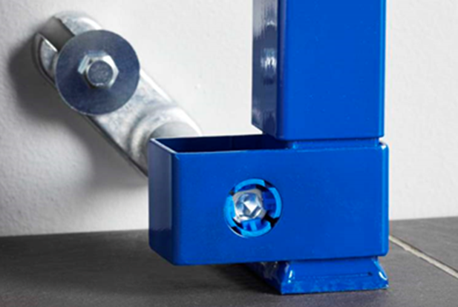
Pipelife Flush & Flow
Floor installation fittings and fasteners
Installation kit for in-wall and bottom mounting with no need for floor installation – available as an accessory

Slide 19
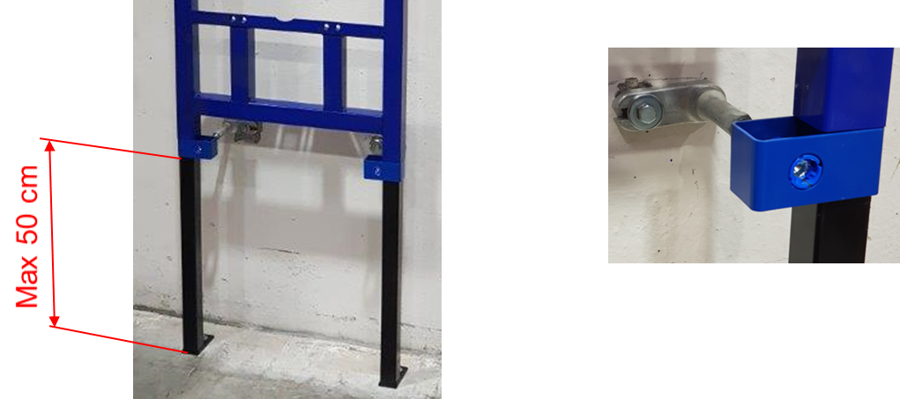
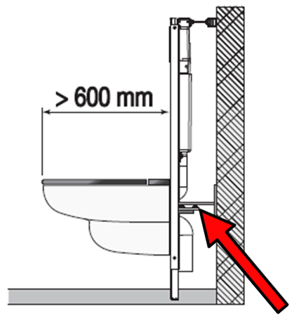
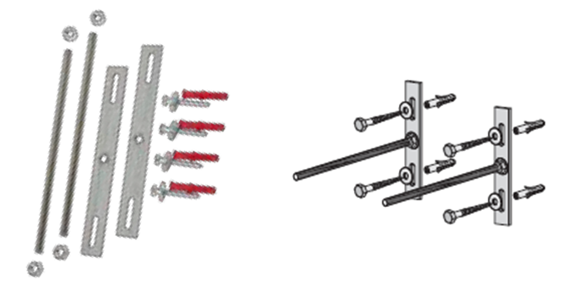
Pipelife Flush & Flow
High level installation kit (toilets for handicapped persons)
DUPLO from 55 to 500 mm
Steady fixation kit – available as an accessory

Slide 20
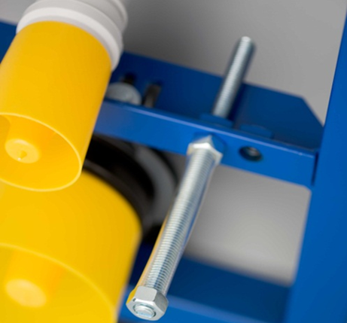
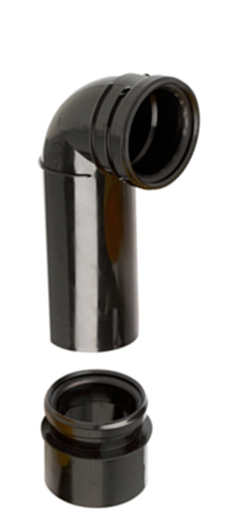
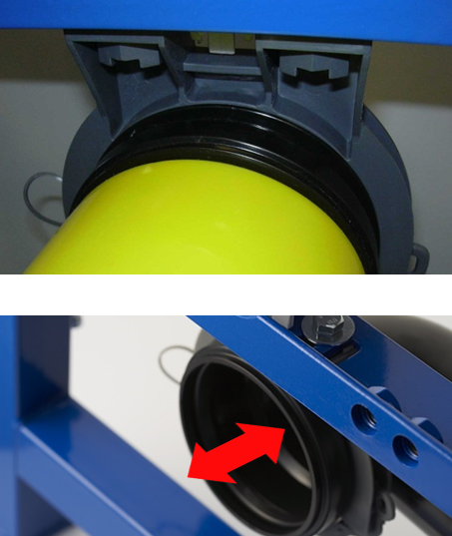
Pipelife Flush & Flow
End caps
  Yellow
  Produced in shapes that can be used as templet for drilling holes
Outlet elbow and adapter
  Click bracket for fixing the outlet elbow
  Depth regulation +/- 10 mm

Slide 21
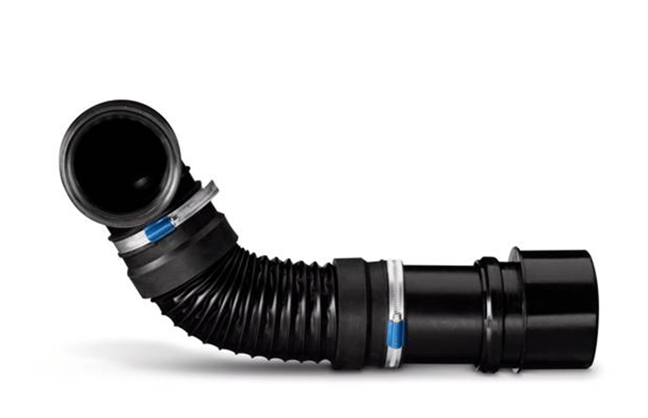
Pipelife Flush & Flow
Flexifon
  Flexible connection to the sewer (Ø 90 mm)
  Easy solution for difficult situations
  Eccentric adapter (Ø 90x110 mm)

Slide 22

Pipelife Flush & Flow
Questions?

Slide 23

Pipelife Flush & Flow
Thank you for
your attention!

